Slide 1
communication & presentation skills SS-152

Slide 2

Week 7 LISTENING skills

Slide 3
Areas to be covered:
Definitions
Difference between hearing and listening.
Objectives and importance of listening.
Listening process.
Strategies for improving listening skills.
Types of listening.

Slide 4
What is listening comprehension?
1. Active process of receiving and responding to spoken messages.
2. It is the ability to accurately receive and interpret messages in the communication process
3. Act of understanding an oral message. It is an extremely complex activity (Buck, 2001) that requires much more than simple perception of the acoustic signal.

Slide 5
What is listening comprehension?
4. It involves speech decoding and comprehending.
5. Listening comprehension is not something that happens because of what the speaker says, but “the listener has a crucial part to play in the process, by activating various types of knowledge and by applying what he knows to what he hears and trying to understand what the speaker means” (Anderson & Lynch, 1988: 6).

Slide 6
Hearing vs listening

Slide 7
Hearing vs Listening
Hearing is simply the act of perceiving sound by the ear. Ends at ‘receiving.’
Hearing occurs with or without our consent
Listening is an action where we actively concentrate on what we hear
In listening our brain processes the information into knowledge
“Listening is not the same as hearing and
hearing is not the same as listening.”

Slide 8
Listening comes first
The first and the foremost communication skill that we learn in our lives is nothing but ‘LISTENING’
LISTENING
SPEAKING
READING
WRITING

Slide 9
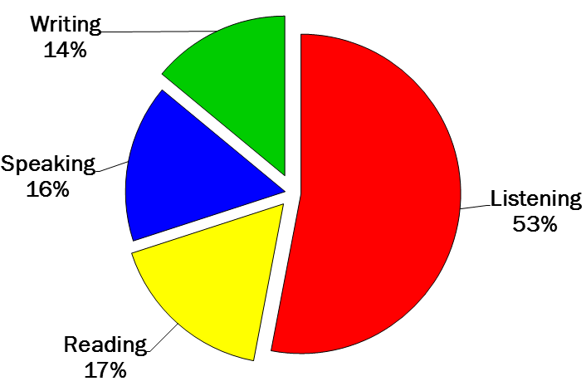

Slide 10
Objectives of learning listening skills

Slide 11
To follow and comprehend discourse such as lectures, conversations, interviews, and discussions
To develop adequate speaking skills to communicate effectively

Slide 12
Importance of listening skills

Slide 13
Communication is not complete without effective listening
An attentive listener stimulates better speaking
A good listener learns more than an indifferent listener
A good listener can restructure vague speaking in a way that produces clearer meaning
A good listener learns to detect prejudices, assumptions and attitudes

Slide 14
What Is Listening?
Listening can be described as a series of five steps: receiving, understanding, remembering, evaluating, and responding.

Slide 16
1. Receiving
Receiving messages is a highly selective process. Listener selectively tune in to the valuable and interesting sounds only.
Verbal and non-verbal cues are recognized.
To improve your receiving skills:
Look at the speaker; make your mind follow your body.
Focus your attention on the verbal and nonverbal messages.
Avoid attending to distractions in the environment.
Focus on speaker`s words rather than on any questions or objections you may have.

Slide 17
2. Understanding
I includes both the thoughts that are expressed as well as the emotional tone that accompanies these thoughts, for example, the urgency or the joy or sorrow expressed in the message.
To enhance understanding:
Relate the new information to what you already know.
See the speaker’s messages from the speaker’s point of view; avoid judging the message until you fully understand it as the speaker intended it.
Rephrase the speaker’s ideas into your own words while listening.

Slide 18
3. Remembering
Messages received and understood should be retained.
What you remember is “your understanding of the message.”
Memory for speech isn’t reproductive; you don’t simply reproduce the received message in your memory. Rather, memory is reconstructive; you actually reconstruct the messages you hear into a system that seems to make sense to you.
In remembering:
Identify the thesis or central idea and the major propositions.
Summarize the message: don`t ignore crucial détails or important qualifications.
Repeat names and key concepts to yourself.
Identify the organizational pattern and use it (visualize it).

Slide 19
4. Evaluating
Evaluating consists of judging the message and the speaker’s credibility, truthfulness, or usefulness.
Here your biases and prejudices may influence what you judge good and bad.
When evaluating:
Resist evaluation until you understand the speaker’s point of view.
Distinguish facts from inferences, opinions, and personal Interpretations.
Identify any biases, self-interests, or prejudices that may hinder meaning making and lets you forget the opposing ideas.

Slide 20
5. Responding
Responding occurs in two phases:
(1) nonverbal (occasionally verbal) responses you make/give while the speaker is talking. Includes (back-channeling cues) include gestures such as nodding your head, smiling, and leaning forward.
(2) responses you make after the speaker has stopped talking.
They include questions of clarification (“I wasn’t sure what you meant by…), expressions of agreement (“You’re absolutely right”), and expressions of disagreement (“I disagree that…”).

Slide 21
4 major causes of poor listening
Not Concentrating
Listening Too Hard
Jumping to Conclusion
Focusing on Delivery & Personal Appearance

Slide 22
How to become a better listener
STRATEGIES FOR IMPROVING LISTENING SKILLS

Slide 23
The three stages of a listening
1. Pre-listening :preparation stage.
Connect prior knowledge with the topic, use guesses to predict.
2. While -listening stage: actual listening & task response.
Listen for major and minor details you need for answers,
Preview the questions before listening, circle the information and listen carefully- analyse the task. Take notes- Comments, outlines, charts, maps, use abbreviations, symbols, intonations etc. re-listen- summarize, use synonyms.
3. Post-listening stage: feedback & remedial work.
Opinionated response, agree, disagree, use symbols-punctuations, summarize, extend listening.

Slide 24
Strategies to be used in order to become a better speaker
Bottom-up process
Top-down process
We use our knowledge of language and our ability to process acoustic signals to make sense of the sounds that speech presents to us.
We infer meaning from contextual clues and from making links between the spoken message and various types of prior knowledge which we hold.

Slide 25
Bottom-up processes
Listeners should retain and recognize:
Input while it is being processed.
Word divisions and key/content words in utterances.
Key transitions in a discourse.
Grammatical relations between key elements in sentences.
The function and purpose of word stress and intonation in sentences.

Slide 26
Top-down processes
While listening, listeners should:
Use key words to identify genre and purpose of the utterance.
Infer the role of the participants, topic, the outcome, the cause and effect of an event.
Infer unstated details, sequence of events and comparisons.
Distinguish between facts and opinions.

Slide 27
Tips for Listening More Effectively
Understand single utterances and relations between utterances or parts of a text.
Obtain the gist or a general impression of the text.
Extract specific information from text-dates, nouns etc.
Deduce unfamiliar or missing meaning.
Understand the text so as to perform a task.

Slide 28
Tips for Listening More Effectively
Listen Actively:
Think about utterances- opining? Questions? Conclusions? Connection of ideas?
Remove distractions, biases, judgements, value the message, Take notes.
In listening for total/general meaning:
Focus on both verbal and nonverbal messages, omissions, consistent and inconsistent packages.
Develop balance between surface and hidden meanings.
Don’t resist or filter out difficult or unpleasant messages.
Listen to the speaker`s feelings as well as to thoughts and ideas- empathy.
Don’t distort messages because of the “friend-or-foe” factor.

Slide 29
Listen with an Open Mind; accept positive criticism
Tips for Listening More Effectively
Avoid prejudging, filtering out difficult, unpleasant, or undesirable messages.
Avoid distorting messages through oversimplification or leveling, the tendency to eliminate details, and to simplify complex messages to make them easier to remember.
Recognize your own biases and avoid assimilation—the tendency to reconstruct messages or make your own explanations according to your own attitudes, prejudices, needs, and values.

Slide 30
In a nutshell.
Take Listening Seriously
Be an Active Listener
Resist Distractions
Don’t be Diverted by Appearance or Delivery
Suspend Judgment- Biases & prejudices
Focus Your Listening
Develop Note-Taking Skills

Slide 31
Types of listening

Slide 32

Types of Listening that people use commonly in Communication

Slide 33
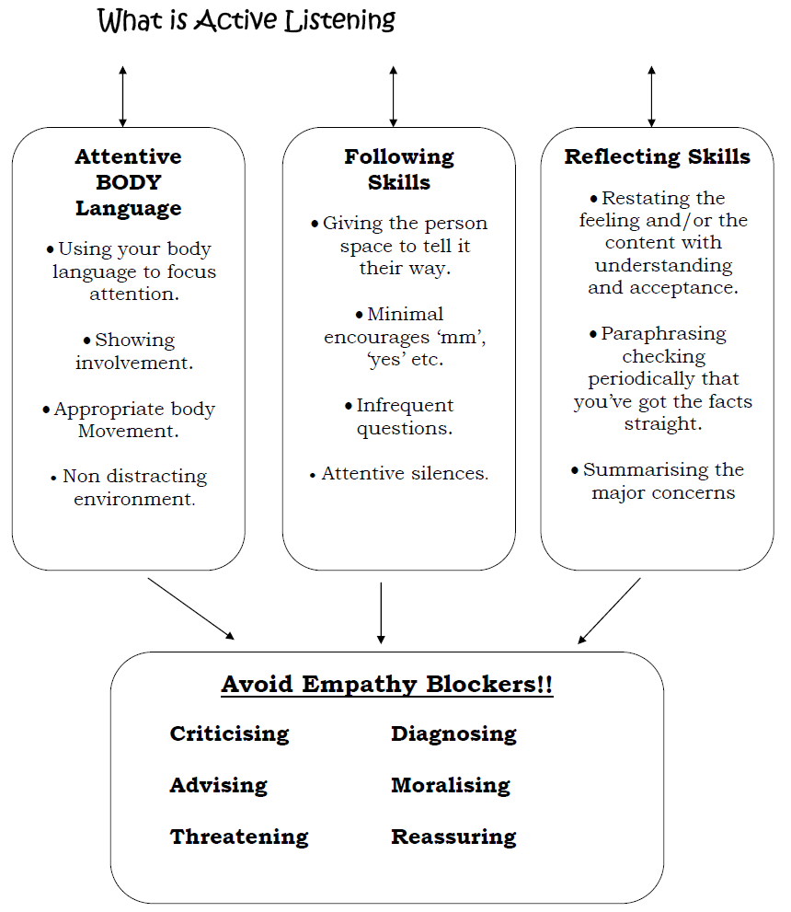

Slide 34
1. Participatory/Active Listening:
It involves physical alertness. Assuming an upright posture. The speaker is focused. Participating in communication interaction as an equal partner with the speaker being emotionally and intellectually ready to engage in the active sharing of the meaning.
(e.g.: discussions, debates, group activities, etc.)
2. PASSIVE/ AESTHETIC/ APPRECIATIVE/EXTENSIVE LISTENING/:
Purpose is pleasure/satisfaction and language improvement. It is listening without reacting. It is a form of one-way communication wherein there is no exchange involved between the interlocutors.
(e.g.: listening to music, radio, recorded lectures, etc.)

Slide 35
3. Surface Listening:
Surface listening is deriving the literal
meaning. In surface listening, we just listen to the surface or superficial things and when we listen we do not focus on the whole message or meanings behind it.
(e.g.: listening to the breaking news, general announcements, etc.)
4. INFORMATIVE/EFFERENT LISTENING
It is a type of goal-based listening that requires the listener to interpret verbal and non-verbal cues, concentrating on the message. This may be the content of a lesson, directions, instructions, etc.

Slide 36
4. DEEP/INTENSIVE/COMPREHENSIVE LISTENING
Such listening is don for the interpretation and deeper understanding of the words, thoughts, ideas, messages and meanings.
Focus is on the speaker, verbal and non-verbal messages in order to understand the speaker’s real intention and the overall meaning.
It refers to" the process of listening for precise sounds words, phrases, grammatical units and pragmatic units"(Rost, 2002, 138).
(e.g.: listening to the teacher, listening to an argument, sermons, etc.)
It demands understanding of the language and vocabulary.

Slide 37
5. DISCRIMINATIVE LISTENING
Where the listener is able to identify and distinguish inferences or emotions through the speaker’s change in voice tone, rhythm, stress, intonation and their use of pause, etc.
Where the listener may recognize and pinpoint a specific engine fault, a familiar laugh from a crowded theatre or their own child’s cry in a noisy playground.

Slide 38
6. EMPATHIC LISTENING/THERAPEUTIC LISTENING
Empathetic listening is to feel what others feel; see the world as they see it, and to relate what they are going through.
The emphasis is on understanding the speaker’s feelings and being supportive and patient.
"Empathic listening provides emotional support for the speaker, as when a psychiatrist listens to a patient.
(e.g.: help the person feel relaxed, understanding special needs etc.)
7. Objective Listening: (Somehow similar to non-judgemental)
Objective listening is to go beyond empathy and measure meaning and feelings against some objective reality. We critically analyze the communication takes place regardless of having any emotions attached.
(e.g.: giving remarks, opinions, evaluating the performance, etc.)

Slide 39
8. CRITICAL/JUDGEMENTAL LISTENING
“It is listening to evaluate a message for purposes of accepting or rejecting it.”
Aim of the listener is to judge whether the speaker is credible, logical, right or wrong, fair or unfair and whether they are being duped or manipulated by the speaker. A position is made known once judging.
AIMS:
- Distinguish opinions from facts.
- Evaluate speakers' qualifications, motives, biases and try to weight fact and arguments.
- Test ideas for effectiveness and appropriateness.
- Recognize the speaker's reasoning and understand the speaker's logic or lack of logic. (Rost ,1994).

Slide 40
9. Non-Judgmental Listening:
With non-judgmental listening, we listen to understand.
Unbiased and unprejudiced. This is easier said than done. We are often unaware we are judging until it's too late.
It means we will listen without allowing ourselves to apply our judgements to what we hear.
(e.g.: students listening to the presentations of their classmates, unable to give suggestions to the boss, etc.)

Slide 41
Factors affecting listening comprehension
Language and Speech: Different people speak with different meanings due to different experiences beliefs, accents, linguistic, non linguistic and paralinguistic knowledge.
Nonverbal Differences Speakers from different cultures have different nonverbal behaviors which are appropriate and inappropriate for a public setting.
Ethnocentrism: The tendency to evaluate the values, beliefs, and behaviors of your own culture as being more positive, logical, and natural than those of others.
The non-ethnocentric would see both himself or herself and others as different but equal, with neither being inferior nor superior.
Gender and Listening:
“women seek to build rapport and establish a closer relationship. Men play up their expertise, emphasize it, and use it to dominate the interaction.”
Deborah Tannen

Slide 42
Task
Listen to the talks on TED talk
Julian Treasure on ‘5 ways to listen better’
https://www.ted.com/talks/julian_treasure_5_ways_to_listen_better?language=en#t-442172
Mathias Basner on ‘Why noise is bad for your health – and what you can do about it’
https://www.ted.com/talks/mathias_basner_why_noise_is_bad_for_your_health_and_what_you_can_do_about_it
After listening both, write a review on them.
Also suggest which type(s) of listening is/are incorporated during the process.

Slide 43
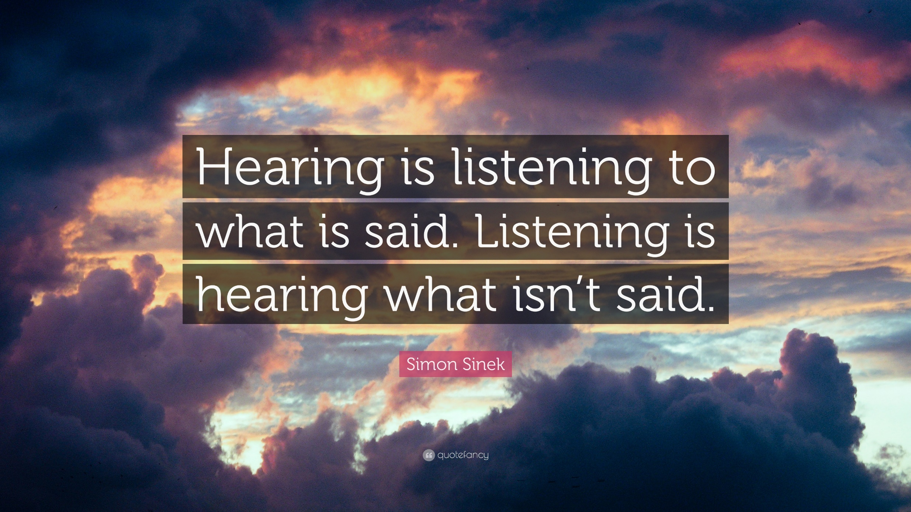

Slide 44
Thanks for listening ☺

